Slide 1

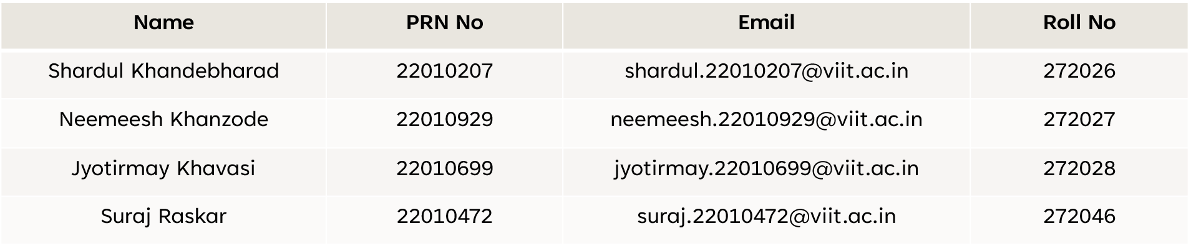
A project on ‘Euler & Hamiltonian Path/Cycle’
ADUA21202: Data Structure
ES21201AD: Discreate Mathematics
ACADEMIC YEAR: 2021-22 SEMESTER: III BATCH: B2
Submitted for fulfilment of Project Based Learning by :

Slide 2



INDEX
Introduction
Euler Path and Circuit
Hamiltonian Path and Cycle
Real-life problems
The Konigsberg Bridge Problem
Applications of Hamiltonian Path
Algorithm
Demonstration

Slide 3
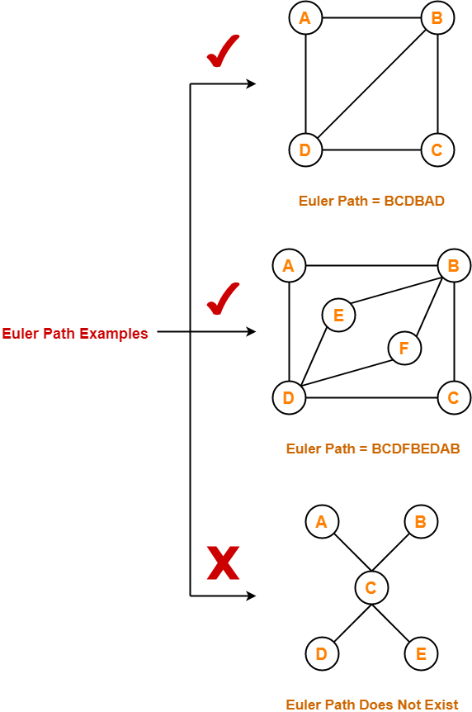
Euler Path
▶ An Euler path is a path that uses every edge of a graph exactly once.
▶ An Euler path starts and ends at different vertices.

Slide 4
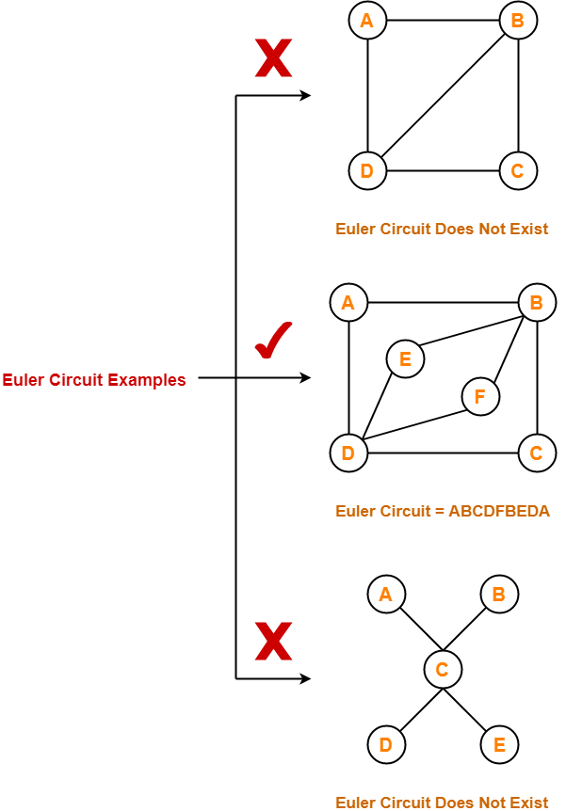
Euler Circuit
▶ An Euler circuit is a circuit that uses every edge of a graph exactly once.
▶ An Euler circuit starts and ends at the same vertex.

Slide 5
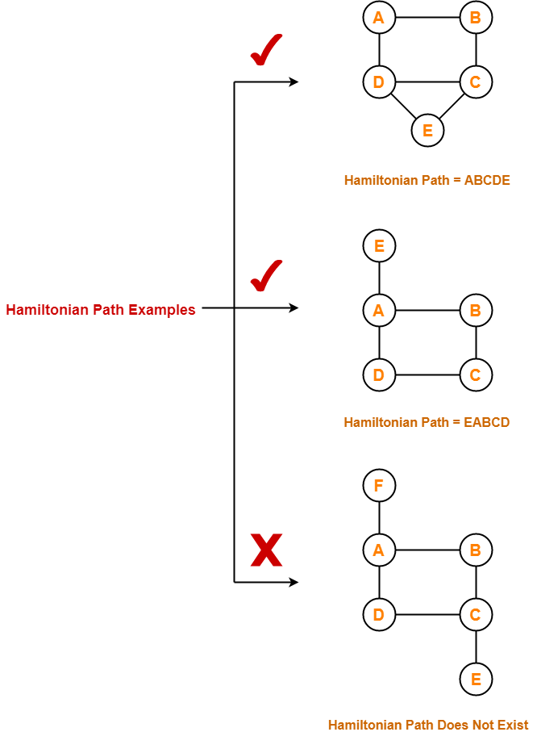
Hamilton’s Path
▶ Hamiltonian path (or traceable path) passes through each vertex (not each edge).
▶ Hamiltonian path can begin and ends on different vertices.

Slide 6
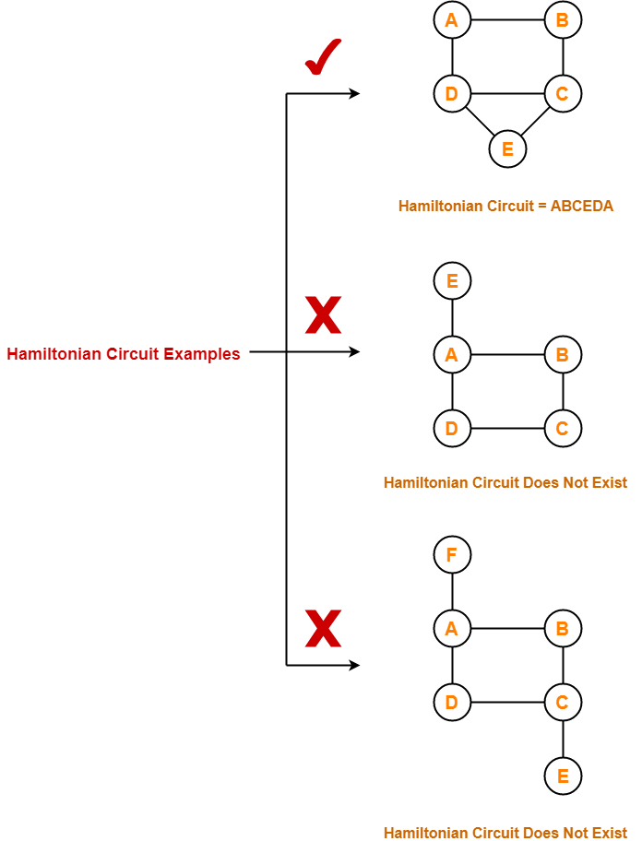
Hamilton’s Circuit
▶ A Hamiltonian circuit is connected to every vertex of the graph exactly once(except starting point).
▶ A Hamiltonian circuit starts and ends at the same vertex.

Slide 7
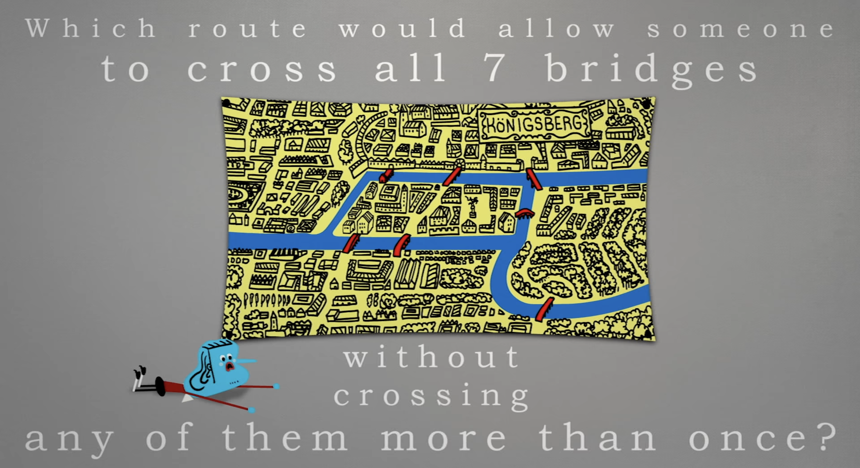

Slide 8
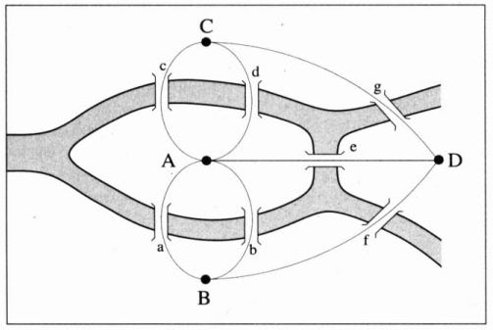
The Konisberg Bridge Problem
Konisberg was a town in Prussia, divided in four land regions by the river Pregel. The regions were connected with seven bridges as shown in figure . The problem is to find a tour through the town that crosses each bridge exactly once.

Slide 9
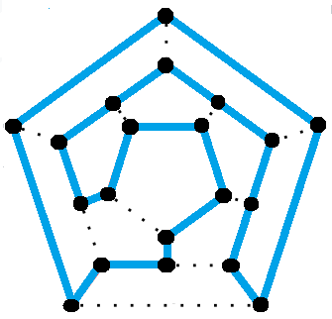
Applications of Hamiltonian Path and cyle
The Icosian game
mapping genomes
electronic circuit design
operations research
Computer graphics

Slide 10
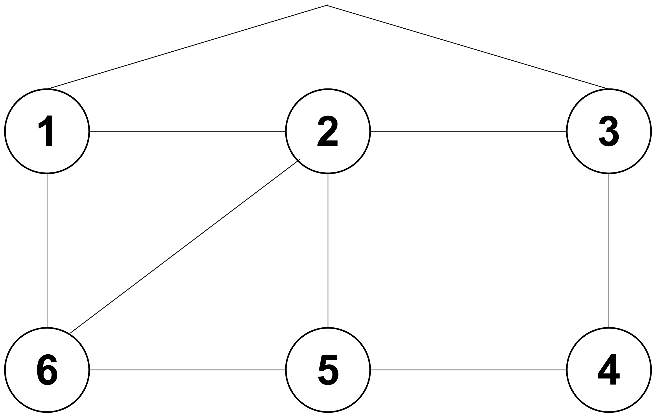
Algorithm Hamiltonian path/circuit (Backtracking Algorithm)
Cycle 1: 1 > 2 > 3 > 4 > 5 > 6 > 1
Cycle 2: 1 > 2 > 6 > 5 > 4 > 3 > 1
Cycle 3: 1 > 6 > 2 > 5 > 4 > 3 > 1
Repetition of Cycle 1:
2 > 3 > 4 > 5 > 6 > 1 > 2

Slide 11
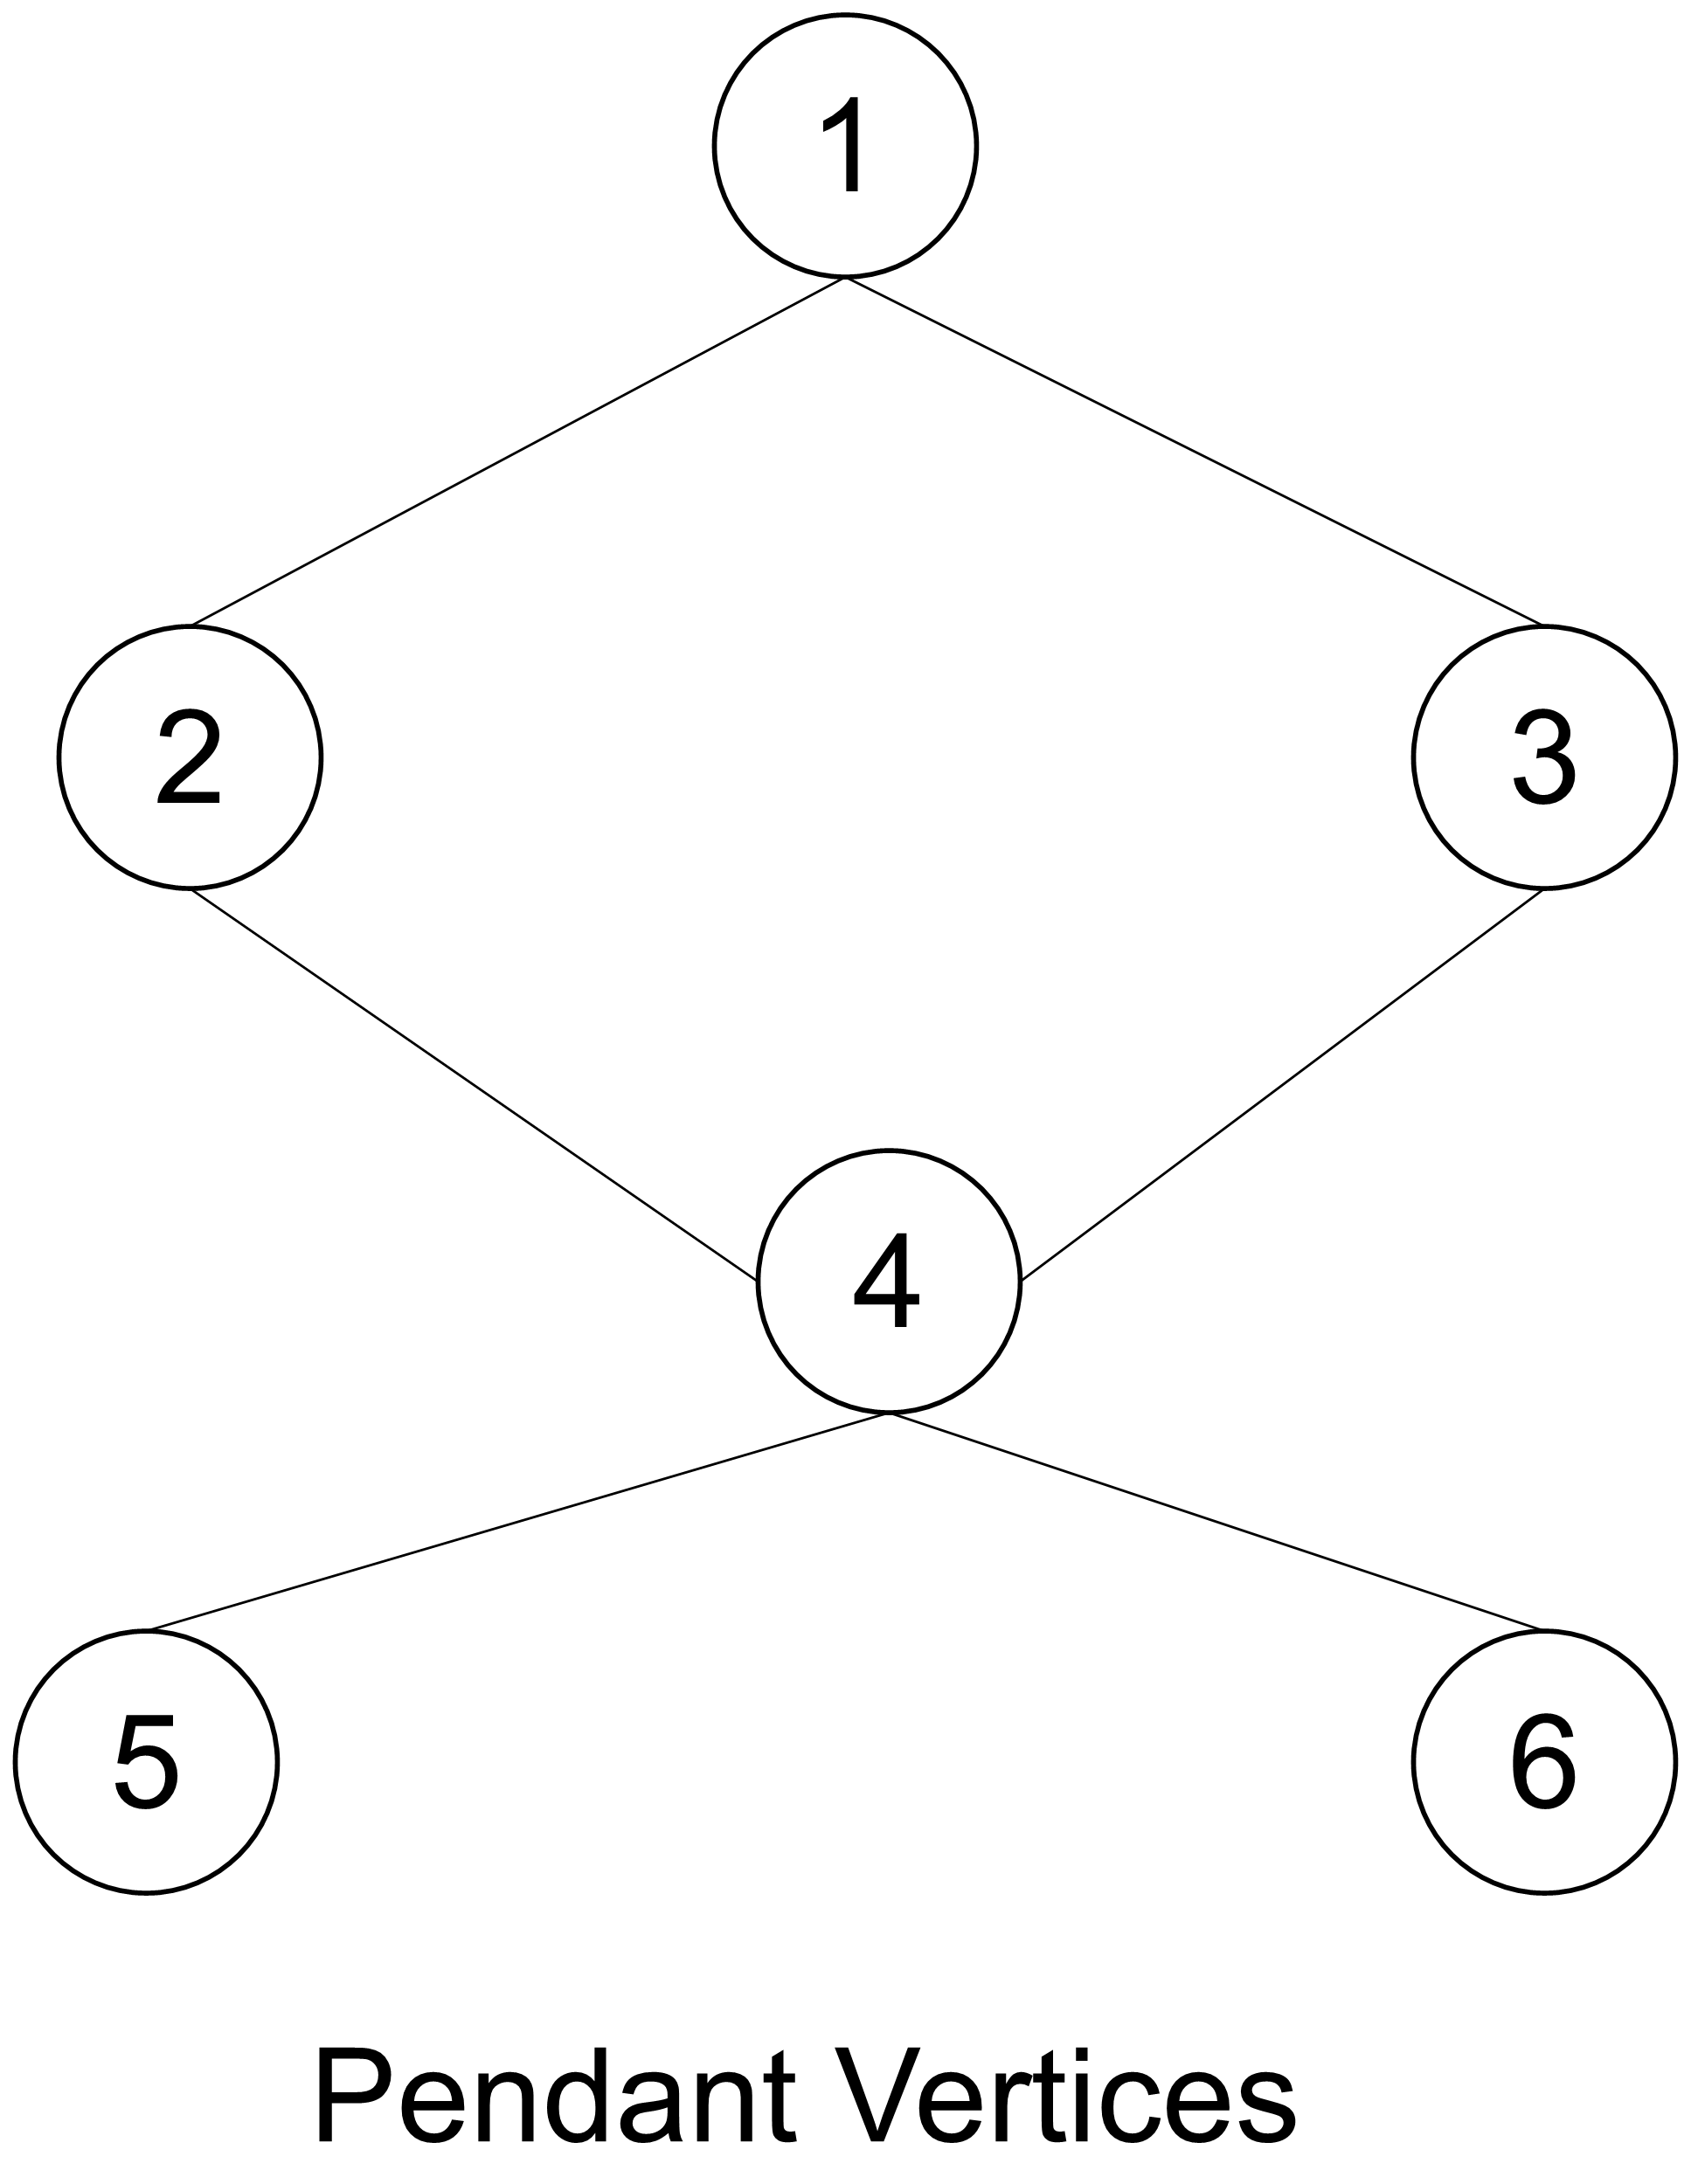
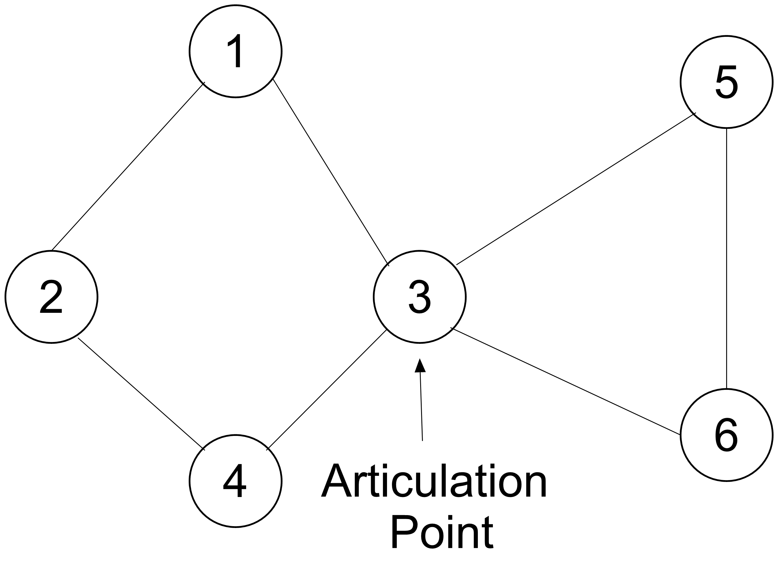
Cases when Hamiltonian graphs don’t exist
When the graph has an articulation point
When the graphs have pendant vertices

Slide 12
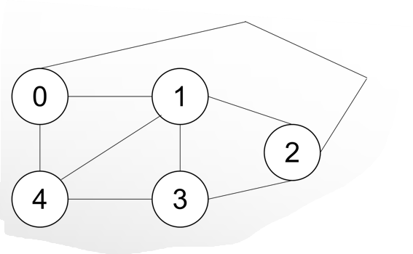
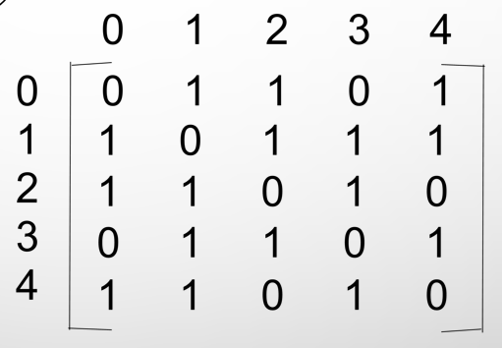

Graph
Adjacency Matrix
Path

Slide 13
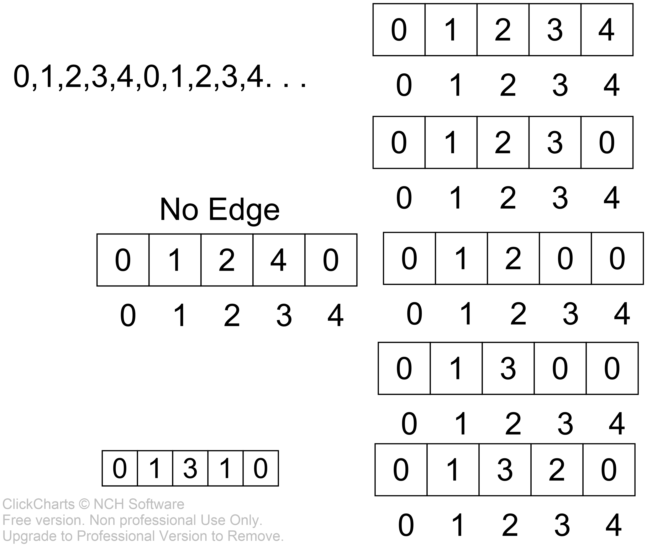
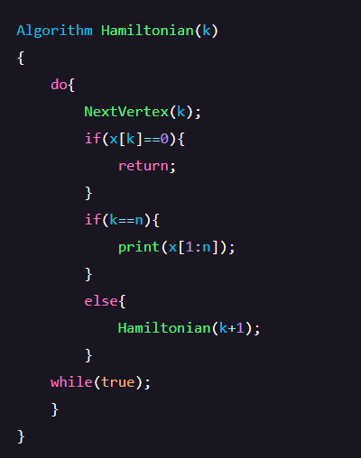
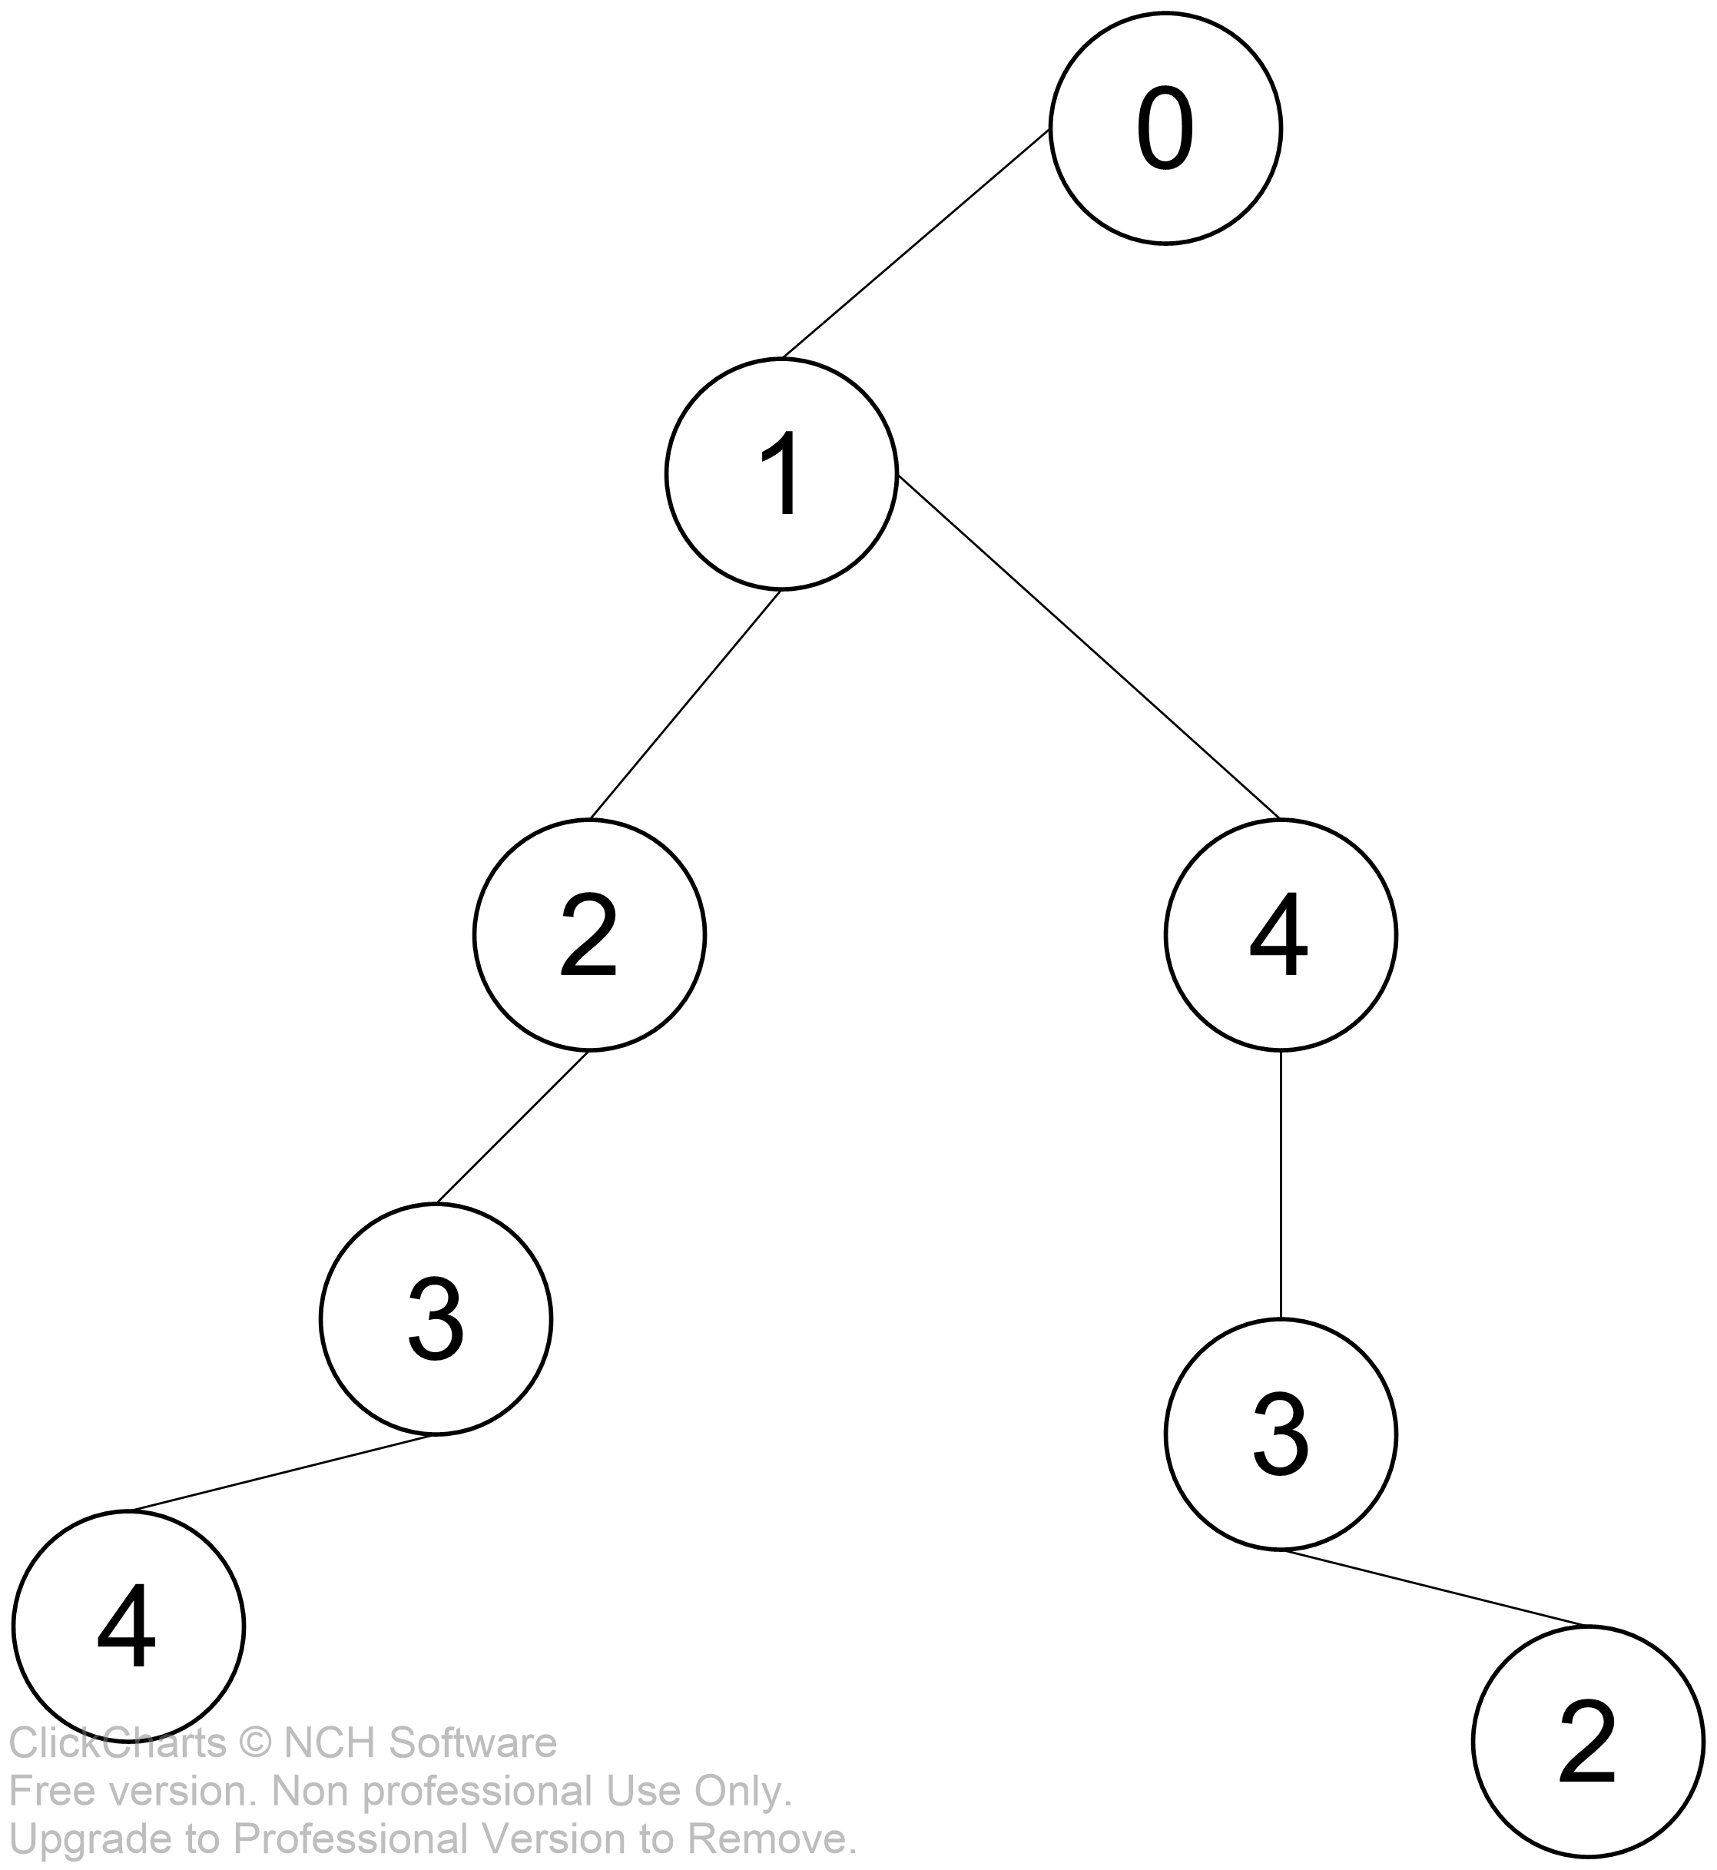
Backtracking works like depth first search. It performs the first search on the problem.

Slide 14
Algorithm Euler’s circuit
Following is Fleury’s Algorithm for printing Eulerian trail or cycle
1. Make sure the graph has either 0 or 2 odd vertices.
2. If there are 0 odd vertices, start anywhere. If there are 2 odd vertices, start at one of them.
3. Follow edges one at a time. If you have a choice between a bridge and a non-bridge, always choose the non-bridge.
4. Stop when you run out of edges.

Slide 15
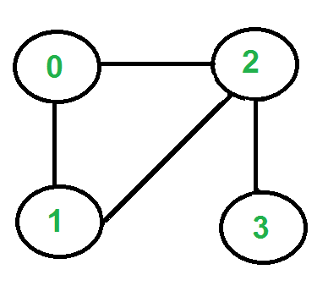

Slide 16
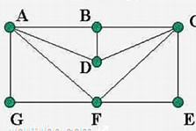
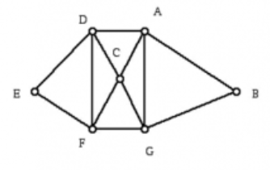
Demonstration
Examples to get the possible Euler and Hamiltonian path/cycle:
Input1:
Number of vertices: 7
Number of edges: 11
Edges:(0,1),(0,3),(0,5),(0,6),(1,2),(1,3),(2,3),(2,4),(2,5),(4,5),(5,6)
Input2:
Number of vertices: 7
Number of edges: 12 Edges:(0,1),(0,2),(0,3),(0,6),(1,6),(2,3),(2,5),(2,6),(3,4),(3,5),(4,5),(5,6)
Run Program

Slide 17

THANK YOU

